Slide 1
Understanding Time Dilation: Types and Implications

Slide 2
agenda
Introduction
Special Relativity and Time Dilation
Lorentz Transformations
Time Dilation Explained
Gravitational Time Dilation
Cosmological Time Dilation
Unifying Perspectives on Time Dilation
Summary

Slide 3
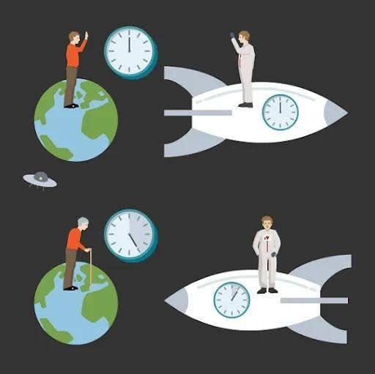
Introduction to Time Dilation
Time dilation is a fascinating concept in physics that describes how time can pass at different rates depending on motion and gravitational influence.
This presentation explores the three main types of time dilation:
Special relativistic time dilation
Gravitational time dilation
Cosmological time dilation
We will delve into the principles behind each type, their mathematical formulations, and their real-world implications.

Slide 4
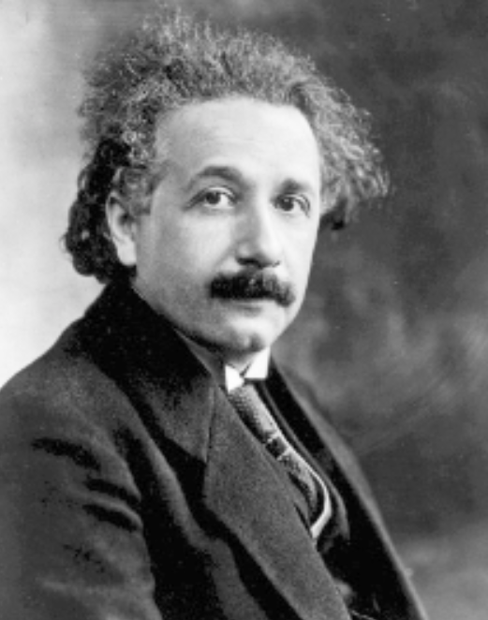

Special Relativity and Time Dilation
Background: The Foundations of Special Relativity:
The concept of time dilation originates from Einstein's theory of special relativity, which was influenced by the Michelson–Morley experiment.
This experiment failed to detect Earth's motion through a supposed medium called "ether," leading to two pivotal postulates by Einstein:
1. The laws of physics are the same for all inertial observers.
2. The speed of light in a vacuum is constant at for all observers, regardless of their motion.
These postulates refuted the notion of ether and laid the groundwork for understanding how time is affected by relative motion.
$$C=3×{10}^{8}$$

Slide 5
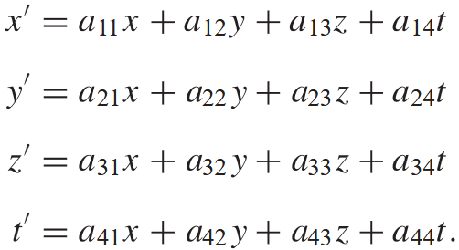
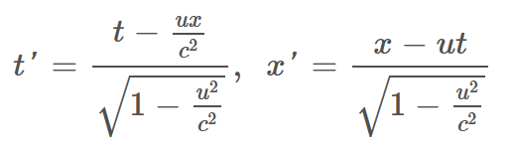
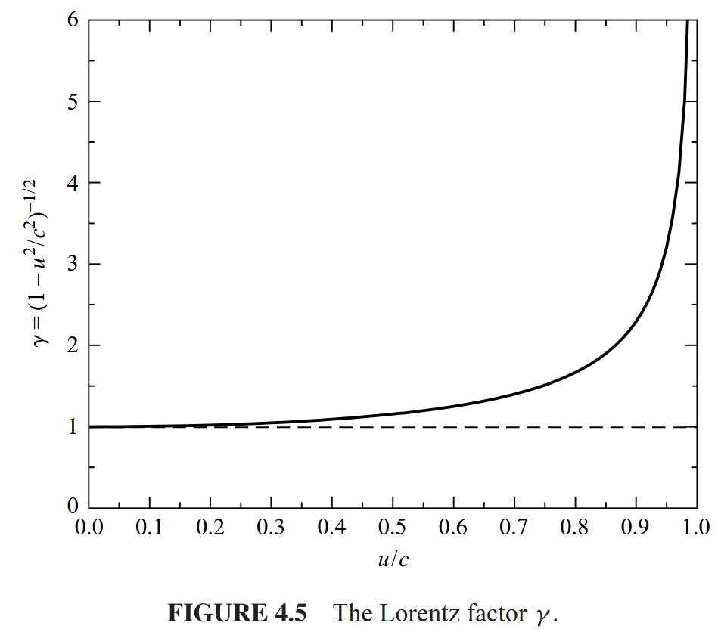
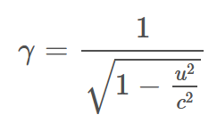
The Lorentz Transformations
The Lorentz transformations are equations that relate the space and time coordinates in different inertial frames.
They are expressed
as follows:
Where:- t’ and x' are the time and space coordinates in the moving frame, t and x are the coordinates in the stationary frame and u is the relative velocity.
The Lorentz factor becomes
significant in determining time
dilation effects.
.

Slide 6
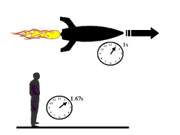
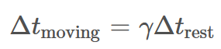
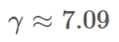
Time Dilation Explained
When comparing two clocks, one at rest and the other moving at a velocity u, the time intervals are related as follows:
This means that moving clocks tick slower than stationary ones, a phenomenon confirmed by experiments with atomic clocks on aircraft.
Example Application: For an object moving
at 99% the speed of light (u = 0.99c):
A clock ticking every second in its rest frame will appear to tick every 7.09 seconds to a stationary observer, illustrating the dramatic effects of time dilation at high speeds.
.

Slide 7
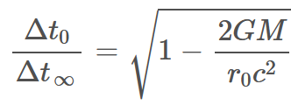
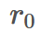
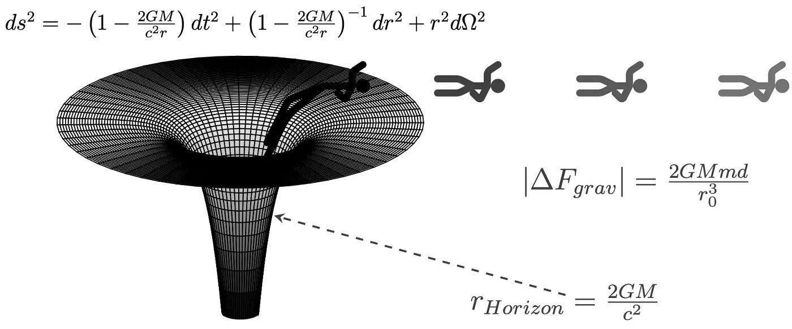
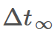
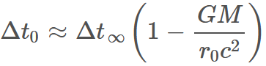
Gravitational Time Dilation
In general relativity, gravity is viewed as the curvature of spacetime instead of a force.
This leads to the conclusion that clocks in stronger gravitational fields (near massive bodies) run slower than those in weaker fields.
Mathematical Description: For a clock
at a distance from a mass M:
Where is the time interval measured at a distance (far from the mass).
Weak-Field Approximation:
This shows how time runs slower in stronger gravitational fields.

Slide 8
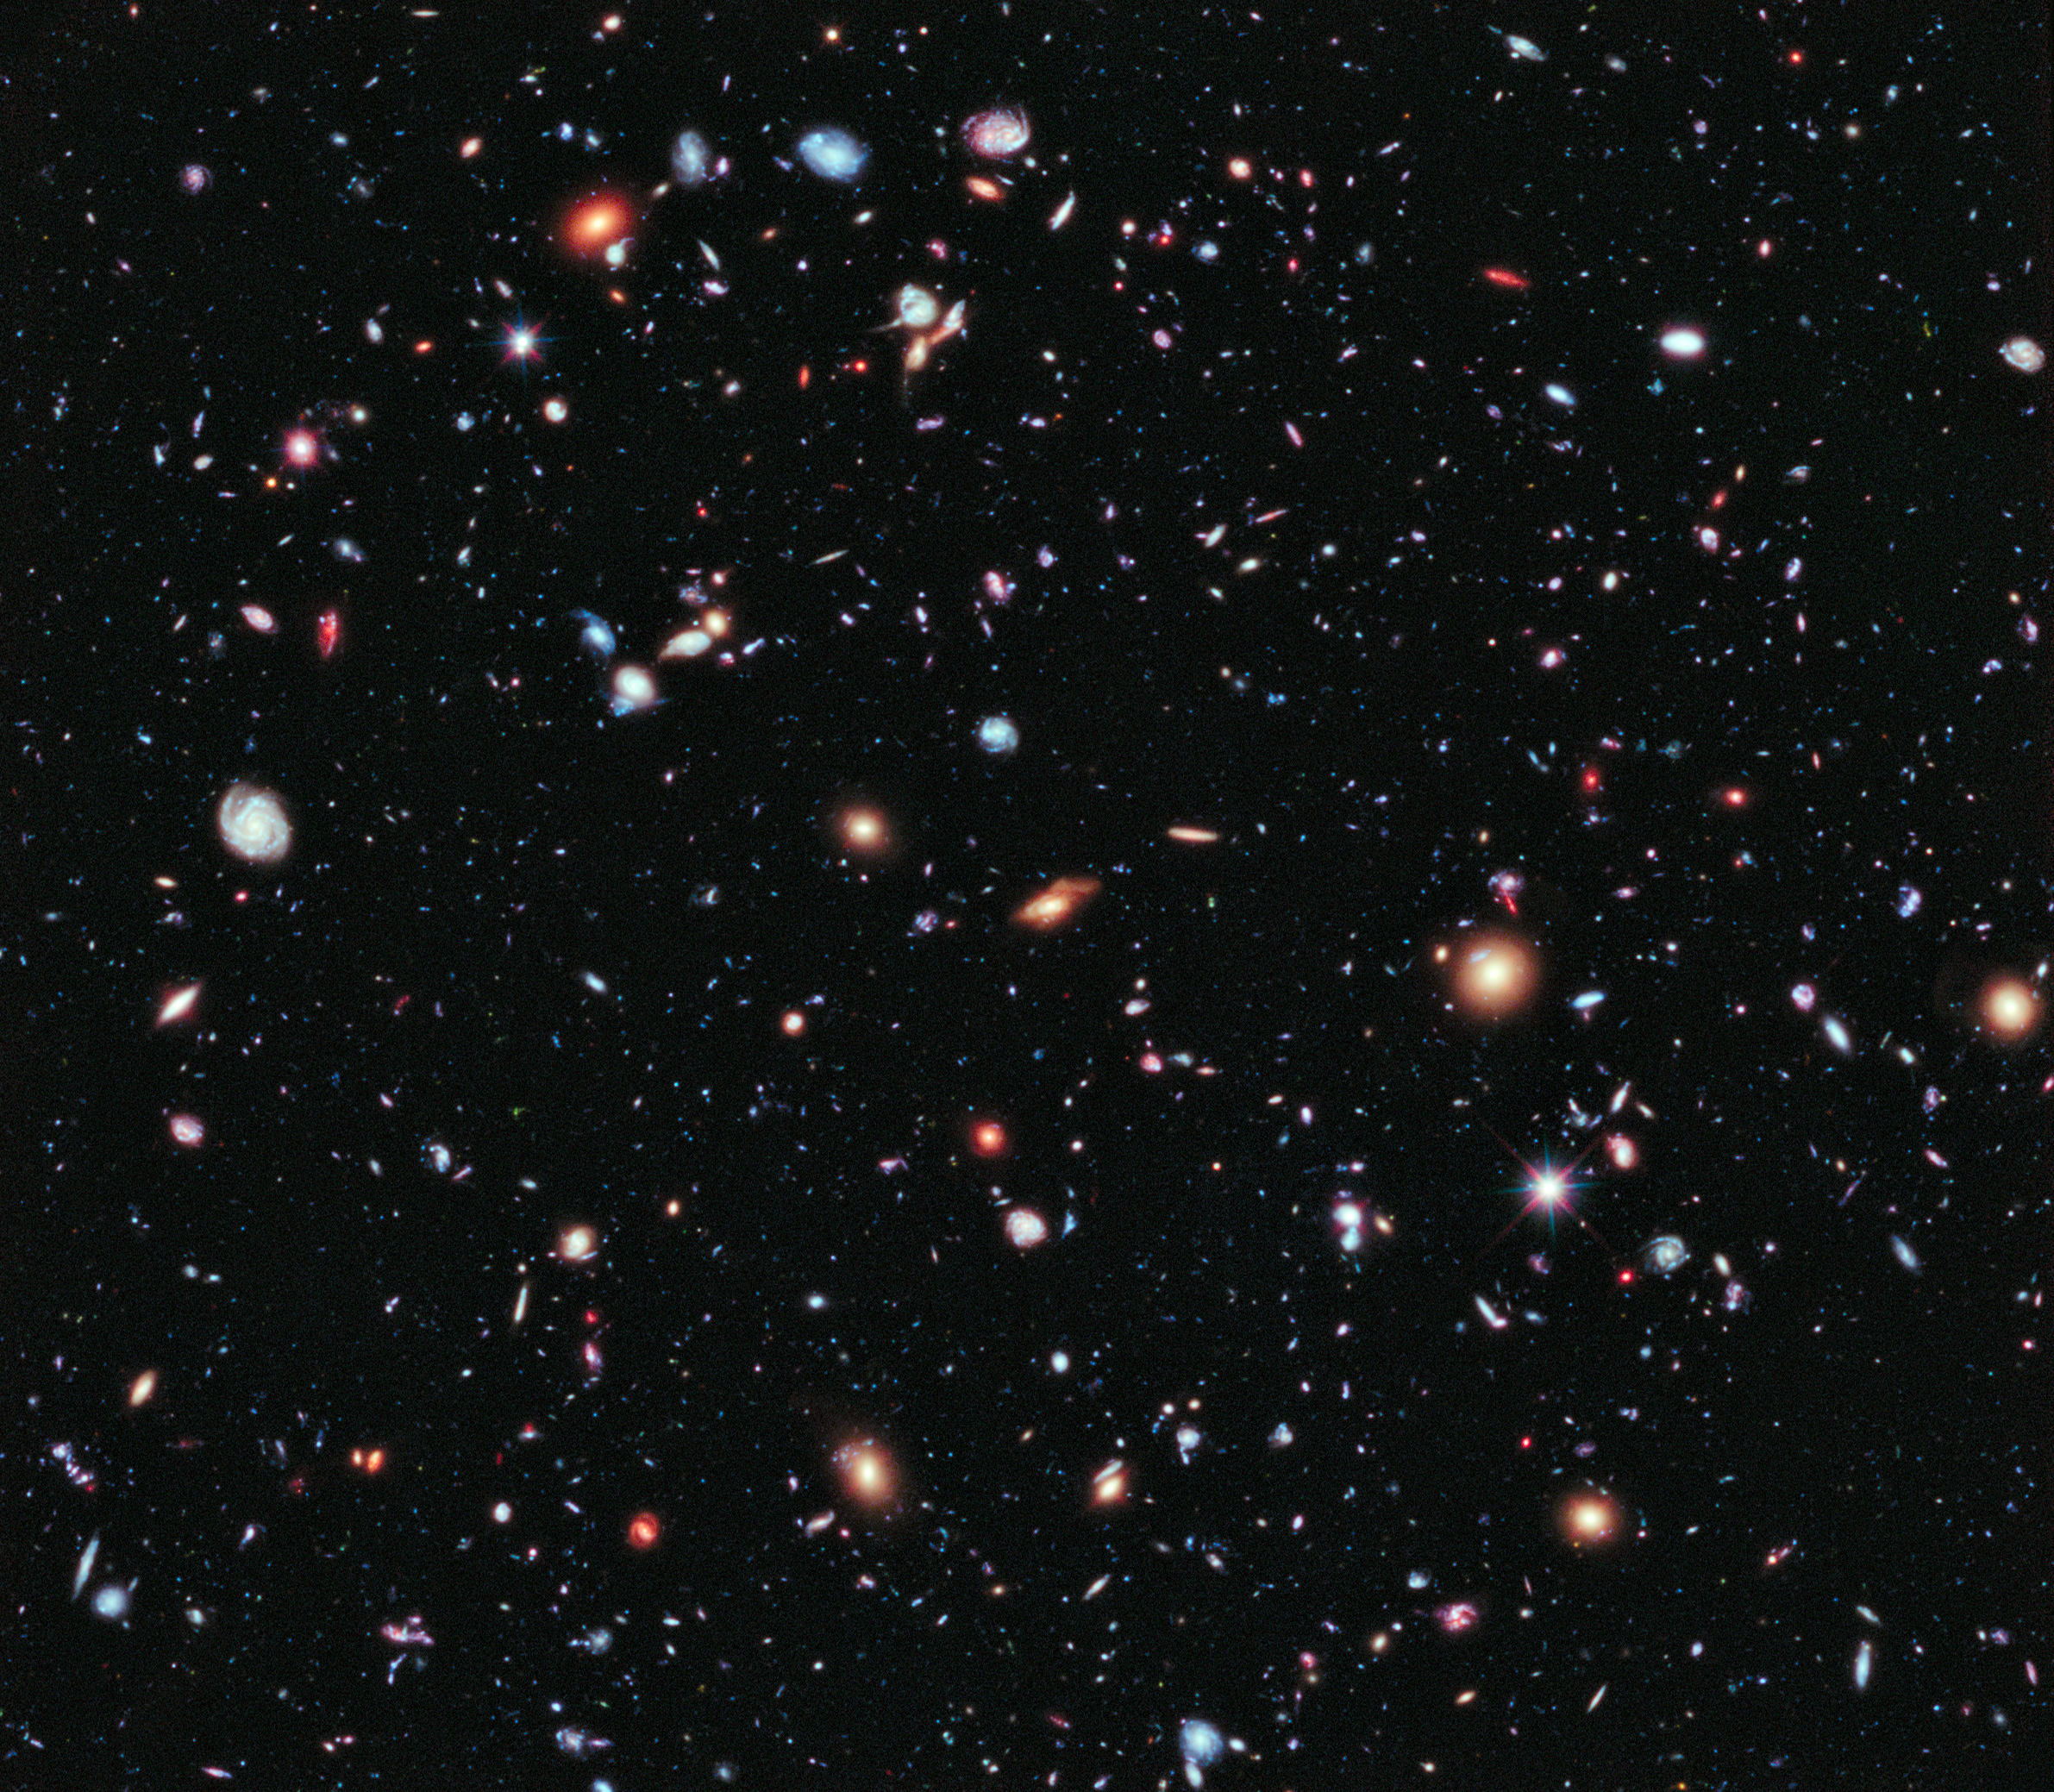
Cosmological Time Dilation
In an expanding universe, the wavelength of light stretches, leading to what is known as cosmological redshift.
This redshift affects not only light but also time intervals.
Mathematical Formulation:
For an event occurring at redshift z :
Example Application : A measurement of cosmological time dilation has been made using the temporal changes in the spectrum of a moderate-redshift (z = 0.361) Type Ia supernova. The results were consistent with equation.
.

Slide 9
Unifying Perspectives on Time Dilation
Connecting the Concepts:
Each type of time dilation reveals the non-absolute nature of time.
Special Relativity: Time dilation due to relative motion.
General Relativity: Time dilation caused by gravitational fields.
Cosmological Time Dilation: Time dilation arising from the universe's expansion.
Together, these concepts illustrate that time is intertwined with both motion and the gravitational dynamics of the cosmos, challenging our intuitive understanding of time as a constant.

Slide 10
Summary
Time dilation is a fundamental concept in physics, showing how time can differ based on motion and gravity.
Special relativity introduces time dilation due to relative velocity, with significant implications at high speeds.
General relativity explains how gravitational fields affect the passage of time, with practical examples in astrophysics.
Cosmological time dilation demonstrates the effect of the universe's expansion on time perception over vast distances.
Together, these types of time dilation reshape our understanding of time as a variable rather than a constant, influenced by various physical phenomena.
.

Slide 11
Thank you
Krishna, Ankit

